Slide 1
Navigation
Notes:
If more than one window's worth, you need to navigate

Slide 2
Three Techniques
Zooming and panning
Overview plus detail
Focus plus context
Notes:
Fundamental problem: show detail but also show everything

Slide 3
Zooming and Panning
Notes:
Zooming=magnifying
Panning=moving side to side

Slide 4
Manipulate the viewport
onto the data space

Slide 5
Types of Zooming
Standard (geometric): see more detail
Semantic: see different representations
Intelligent, fisheye: focus plus context
Notes:
Standard – makes details bigger/smaller
Semantic – different representation (good maps do this)
Intelligent = Fisheye = focus plus context, zoom within fixed overview, distort edges of zoomed area

Slide 6
Standard vs. Semantic Zooming
Standard
View depends on physical properties of object
Zoom out: see smaller version
Zoom in: see larger version
Semantic
View depends on semantic meaning of object at that scale
Zoom out or in: see different representation
Notes:
Powers of Ten movie outbound is standard, inbound is semantic

Slide 7
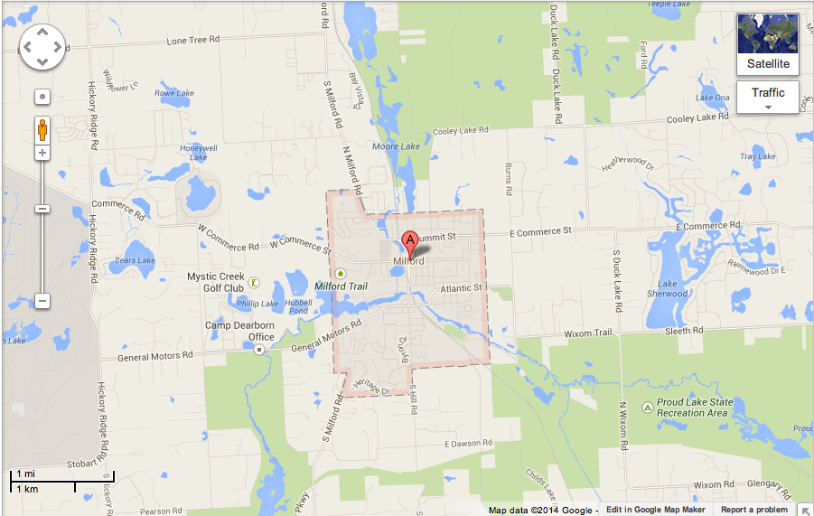
Semantic Zooming in Maps
Notes:
My home town
Notice A marker
Almost nothing there, just a couple street labels

Slide 8
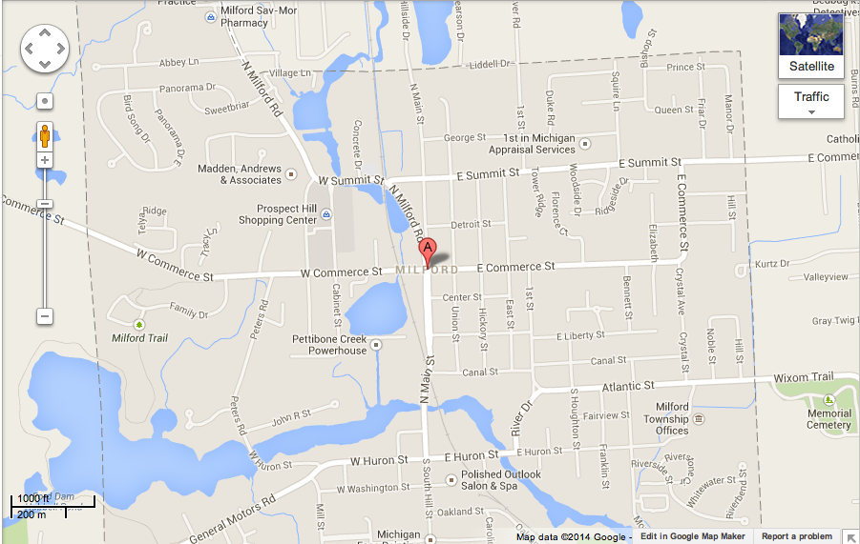
Semantic Zooming in Maps
Notes:
Lots of new detail that wasn't there before

Slide 9
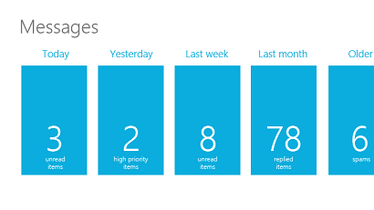
Semantic Zoom in Windows
Zoomed-out view
Notes:
Message UI for Windows 8
Zoomed out, see a summary of messages for each day

Slide 10
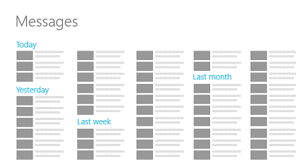
Semantic Zoom in Windows
Zoomed-in view
Notes:
Zoomed in, you get details for each day

Slide 11
Zooming and Panning Together
Zooming is logarithmic
Panning is linear
If calculated separately, panning can't keep up with zooming
Notes:
pan target runs away

Slide 12
Zooming and Panning Together
What if you pan from one zoomed-in spot to another near the same zoom but far away?
How do you keep it smooth and efficient?
Notes:
What if the start and finish are near the same zoom factor but far apart by panning?
Can't just interpolate
Too much optic flow

Slide 13
One Possibility
Pan waaaaaaay over
Start
Finish
Really Big Map
Notes:
Move dominated by pan, can seem to take forever

Slide 14
Another Possibility
Zoom out, pan, then zoom back in
Start
Really Big Map
Finish
Notes:
Zoom out, pan a little, zoom back in is better

Slide 15
Better Possibility
Zoom out, pan, then zoom back in smoothly
Start
Really Big Map
Finish
Notes:
But we want a smooth experience
How do you figure out the best trajectory?

Slide 16
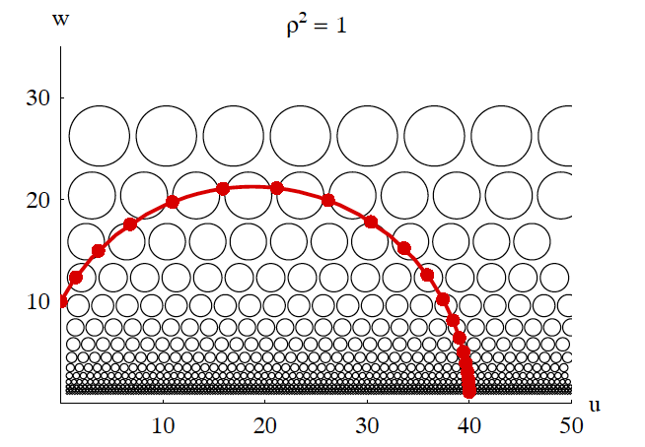
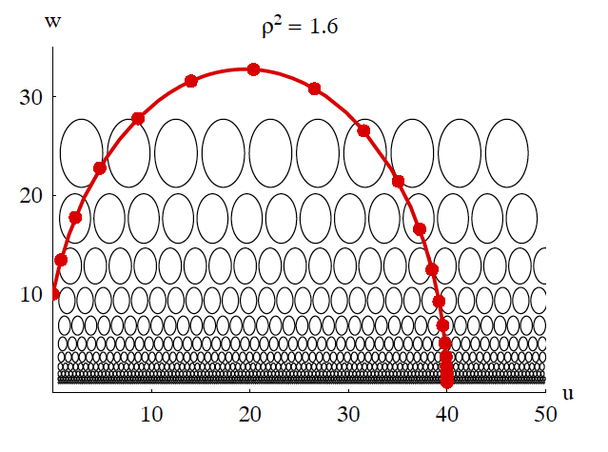
van Wijk and Nuij, 2003
Notes:
Van Wijk and Nuij studied what users prefer.
Change in rho
Trade-off between zooming and panning –
people preferred more perception of zooming

Slide 17
Zoom in D3
Automatic transitions for zoom behavior
transition.call()
Notes:
D3 has automatic transitions for zoom behavior using transition.call applies vanWijk and Nuij’s zooming
https://bl.ocks.org/mbostock/6238040

Slide 18
Overview Plus Detail

Slide 19
Overview Plus Detail
Overview and detail shown simultaneously
Two separate views
No distortion

Slide 20
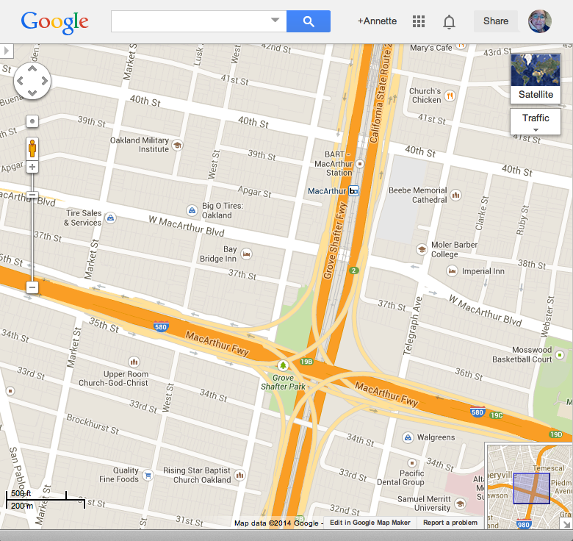
Google Maps
Detail
} Overview

Slide 21
Drawbacks
User has to shift attention
Both views take up space
You lose some context in overview

Slide 22
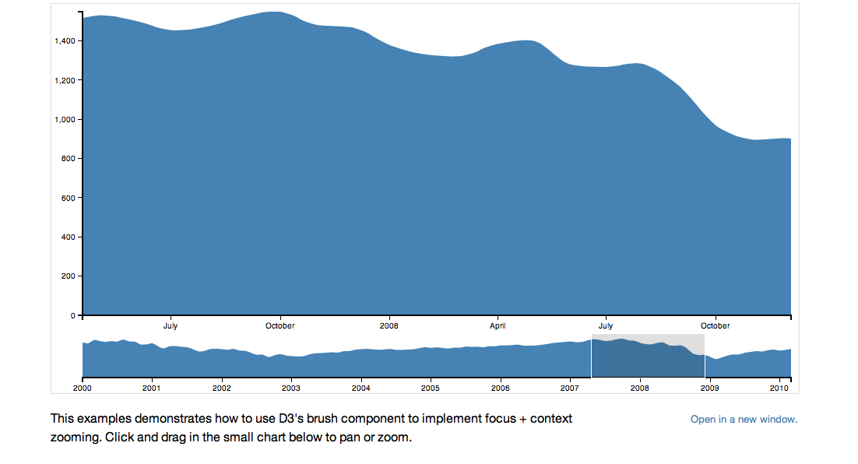
http://bl.ocks.org/mbostock/1667367
Brush & Zoom
Notes:
D3 has sample code, Brush and Zoom

Slide 23
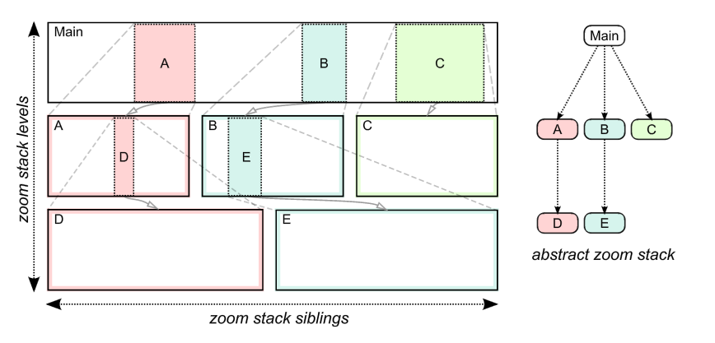
Stacked Zoom
Diagram Source: Javed, W., & Elmqvist, N. (2010, March). Stack zooming for multi-focus interaction in time-series data visualization. In Visualization Symposium (PacificVis), 2010 IEEE Pacific (pp. 33-40). IEEE.
Notes:
http://citeseerx.ist.psu.edu/viewdoc/download?doi=10.1.1.443.1483&rep=rep1&type=pdf

Slide 24
Pan/Zoom vs. Overview/Detail
Why not do both?
Pietriga et al. (2007)
Zoom and pan
Fisheye distortion lens
Overview + detail lens ("dragmag") (second best)
Overview + detail with zoom and pan (best)

Slide 25
Focus Plus Context

Slide 26
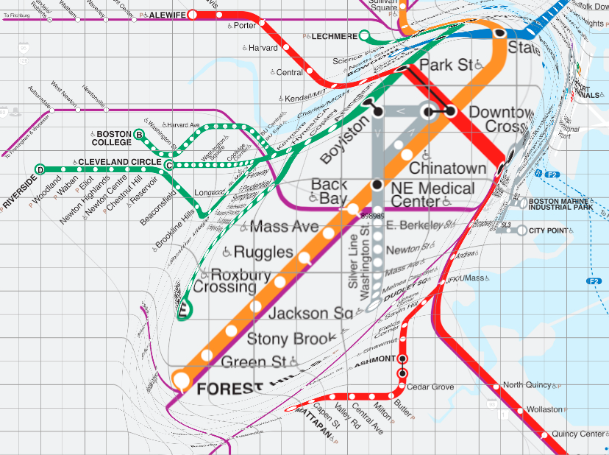
Focus Plus Context
Shows overview and detail
No separate view
Often uses distortion to show context
http://www.olivierbau.com

Slide 27
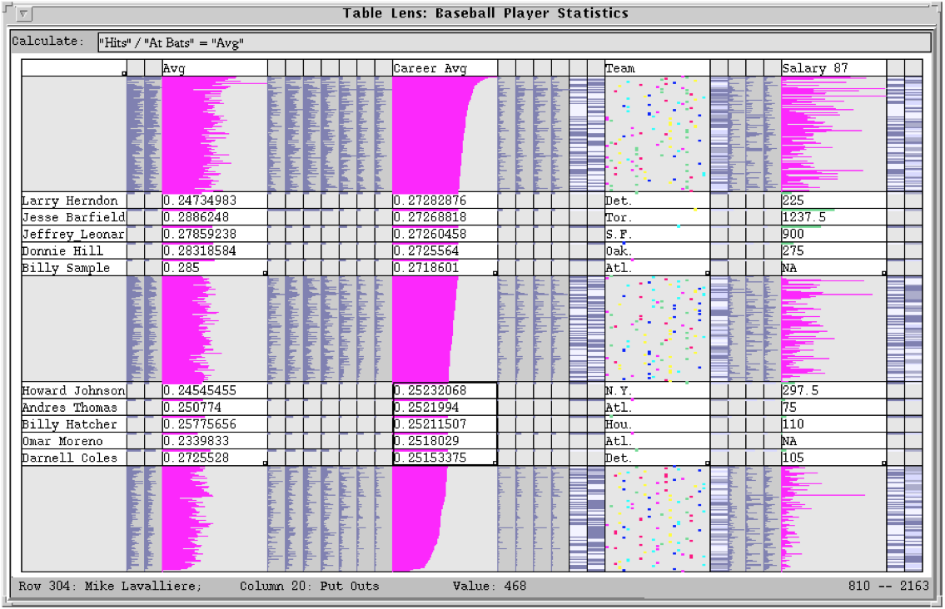
TableLens
Ramana Rao and Stuart Card, PARC, 1994
Notes:
essentially a table of small multiples
zoomed rows, columns show detail
applies spatial concept to graphs

Slide 28
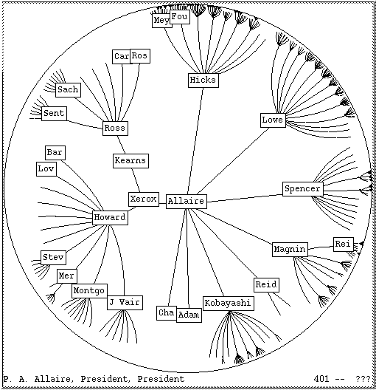
Hyperbolic Tree
John Lamping, Ramana Rao, and Peter Pirolli, PARC, 1995
Notes:
tree diagram, not network
also called hypertree
selected node centered
farther away branches are more compressed

Slide 29
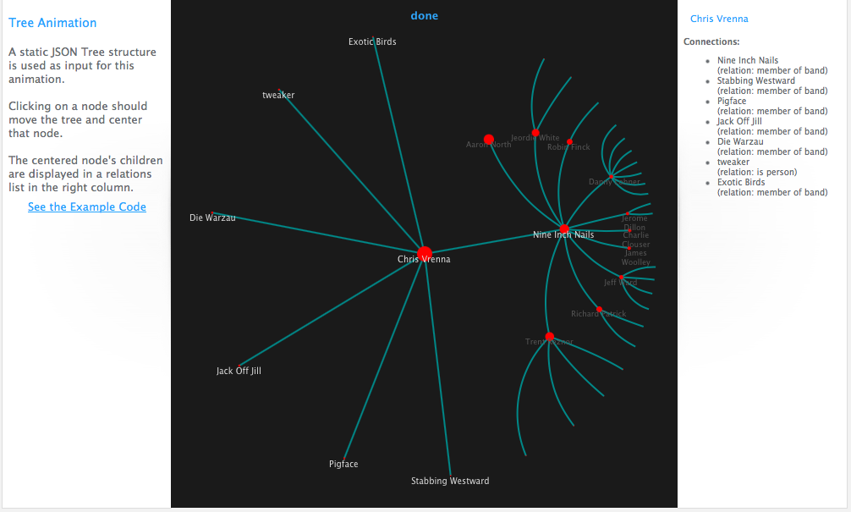
Javascript Infovis Toolkit Hypertree
http://philogb.github.io/jit/static/v20/Jit/Examples/Hypertree/example1.html
Notes:
JIT library includes a hypertree

Slide 30
Drawbacks
Distorted data can be hard to interpret
Distorted labels can be hard to read

Slide 31
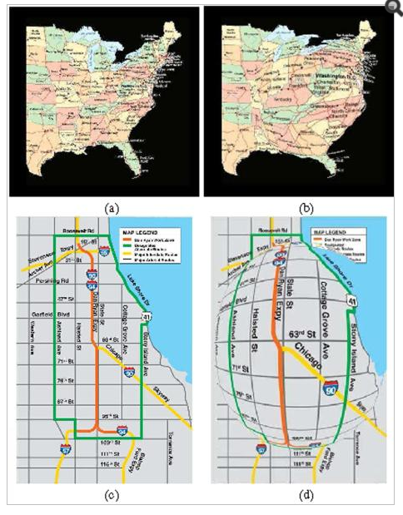
Conformal Magnifier
[Zhao et al., 2012]
Notes:
Our tools keep getting better!

Slide 32

Notes:
The tools keep getting better

